Slide 1

MACHINE LEARNING MINI PROJECT

Slide 2
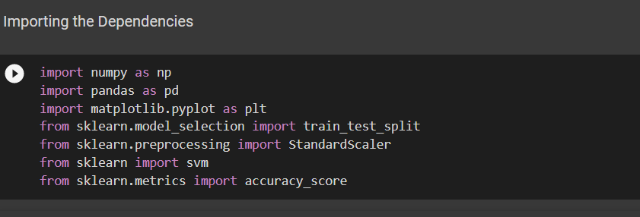
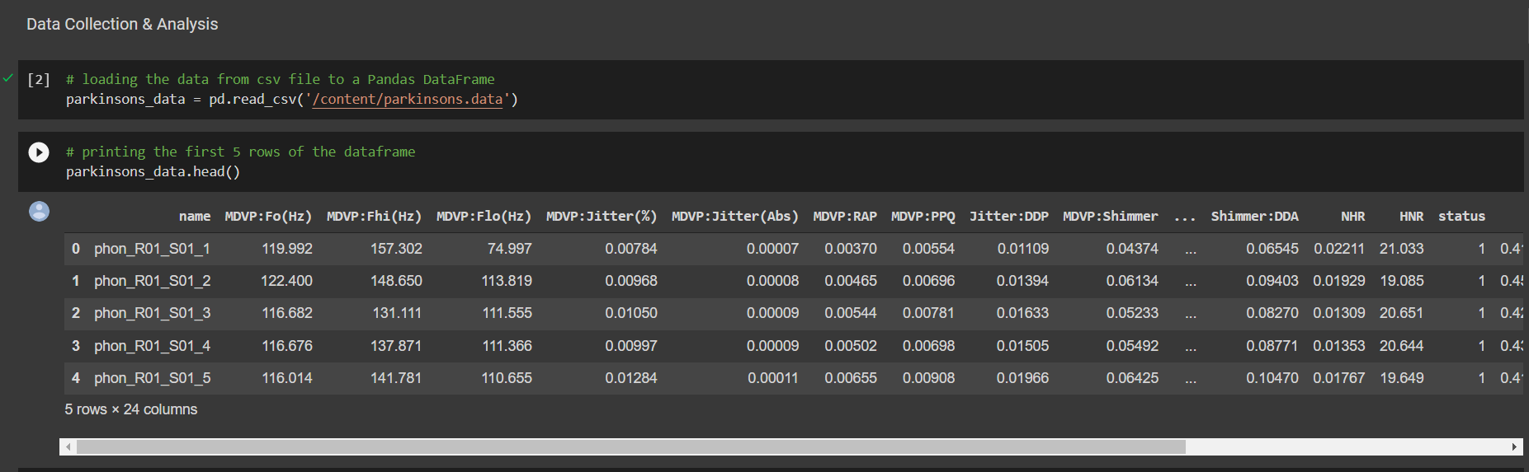
Importing data set from drive
PARKISONS DATA SET

Slide 3
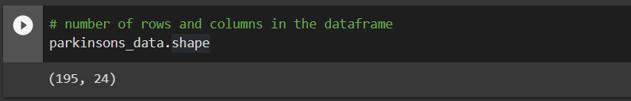
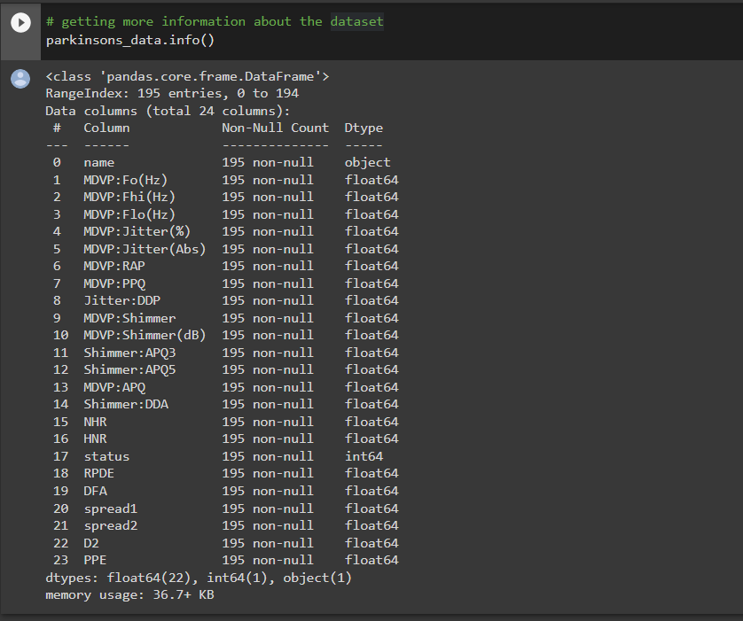
getting more information about the dataset
Number of rows and columns in the data frame

Slide 4
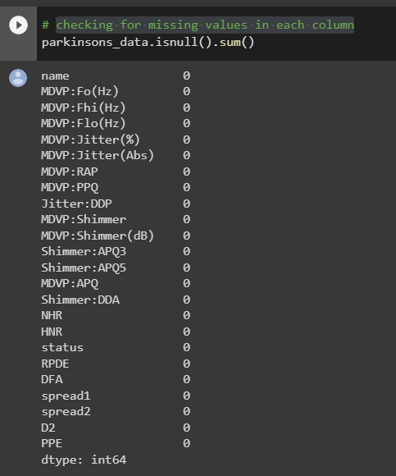
checking for missing values in each column

Slide 5
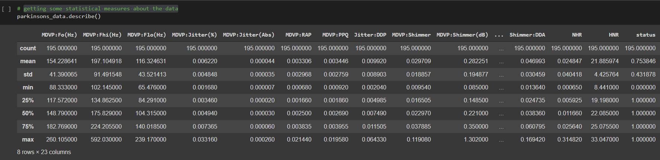
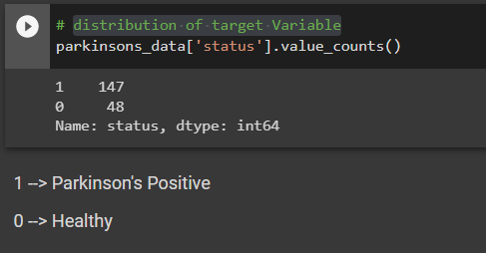
getting some statistical measures about the data
Distribution of target Variable

Slide 6
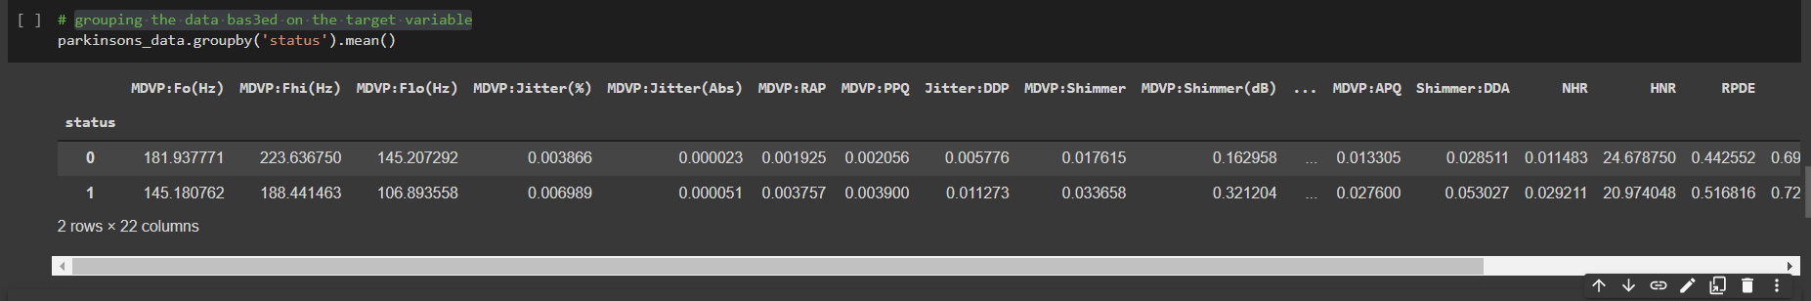
grouping the data bas3ed on the target variable

Slide 7
Data Pre-Processing

Slide 8
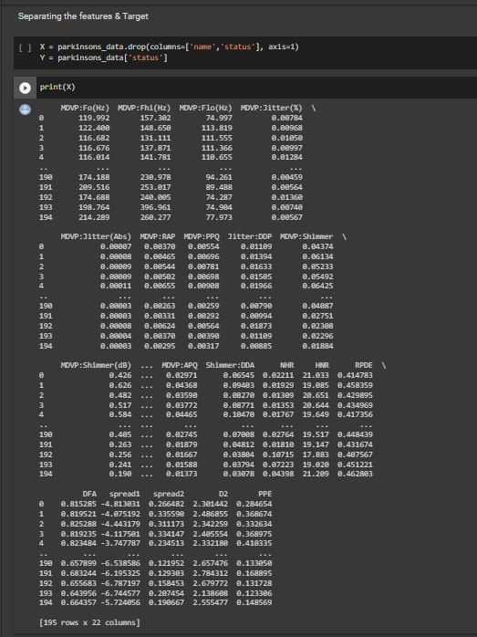
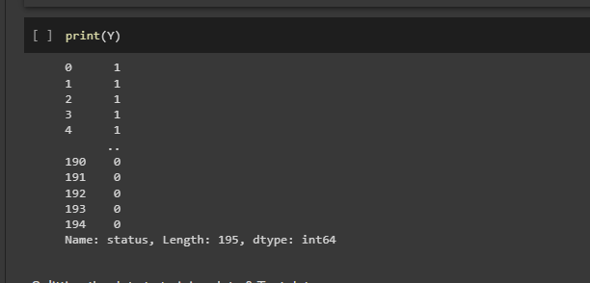
Separating the features & Target

Slide 9
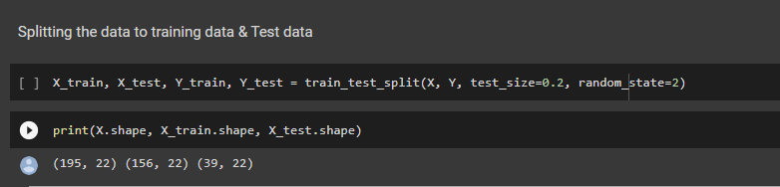
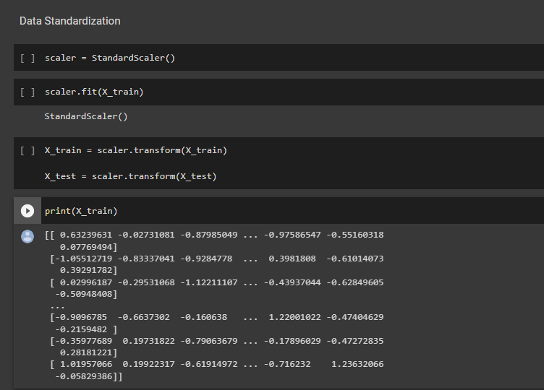
Splitting the data to training data & Test data
Data Standardization

Slide 10
SUPPORT VECTOR MACHINE
Support Vector Machine or SVM is one of the most popular Supervised Learning algorithms, which is used for Classification as well as Regression problems. However, primarily, it is used for Classification problems in Machine Learning.
The goal of the SVM algorithm is to create the best line or decision boundary that can segregate n-dimensional space into classes so that we can easily put the new data point in the correct category in the future. This best decision boundary is called a hyperplane.

Slide 11
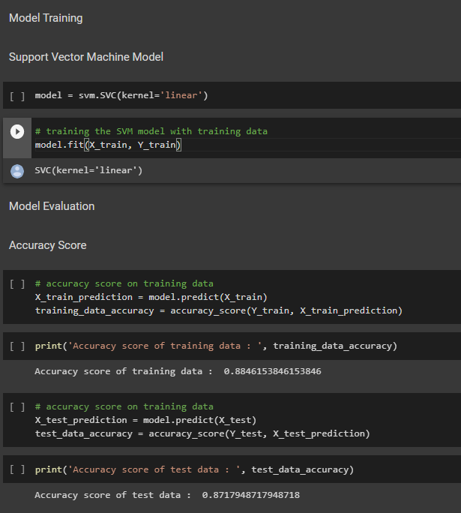
Support Vector Machine Model
Model Training

Slide 12
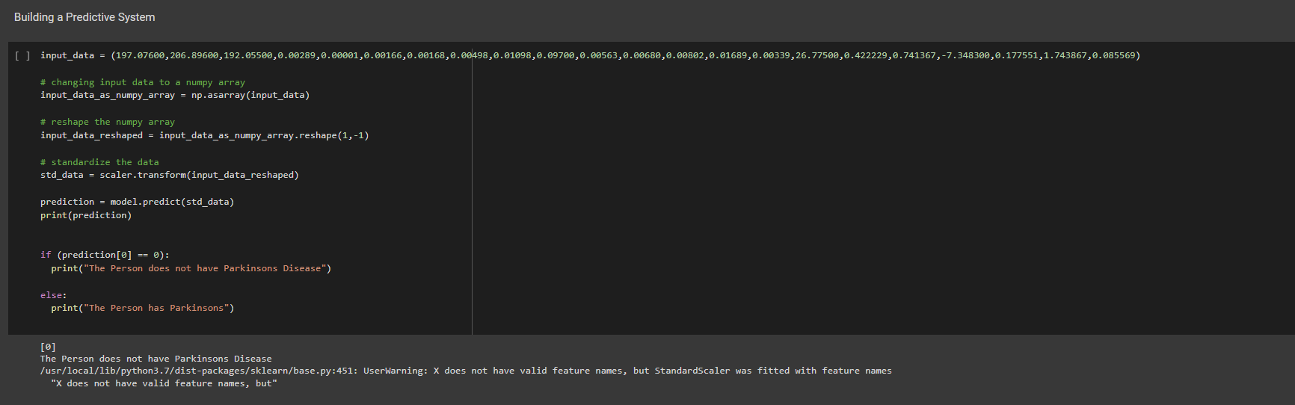

Slide 13
RANDOM FOREST
Random Forest is a popular machine learning algorithm that belongs to the supervised learning technique. It can be used for both Classification and Regression problems in ML. It is based on the concept of ensemble learning, which is a process of combining multiple classifiers to solve a complex problem and to improve the performance of the model.
As the name suggests, "Random Forest is a classifier that contains a number of decision trees on various subsets of the given dataset and takes the average to improve the predictive accuracy of that dataset." Instead of relying on one decision tree, the random forest takes the prediction from each tree and based on the majority votes of predictions, and it predicts the final output.
The greater number of trees in the forest leads to higher accuracy and prevents the problem of overfitting.

Slide 14
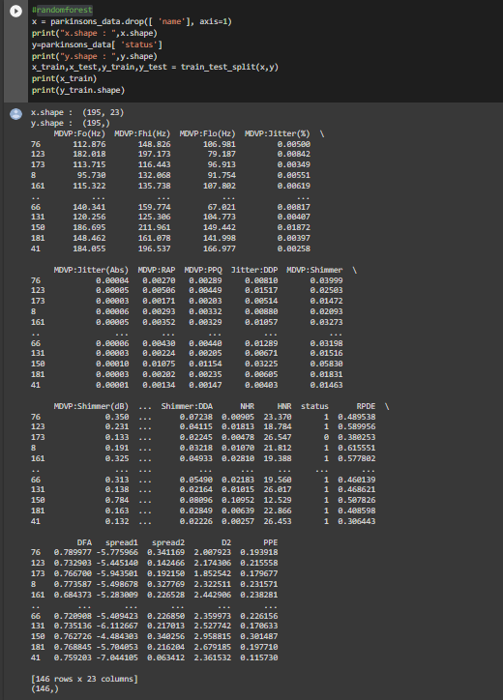
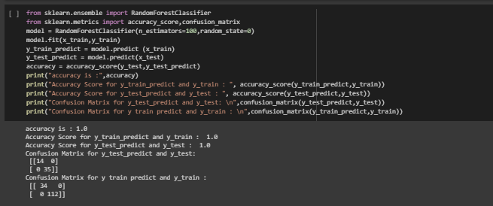
Random forest

Slide 15
Logistic regression
Logistic regression is one of the most popular Machine Learning algorithms, which comes under the Supervised Learning technique. It is used for predicting the categorical dependent variable using a given set of independent variables.
Logistic regression predicts the output of a categorical dependent variable. Therefore the outcome must be a categorical or discrete value. It can be either Yes or No, 0 or 1, true or False, etc. but instead of giving the exact value as 0 and 1, it gives the probabilistic values which lie between 0 and 1.
Logistic Regression is much similar to the Linear Regression except that how they are used. Linear Regression is used for solving Regression problems, whereas Logistic regression is used for solving the classification problems.
In Logistic regression, instead of fitting a regression line, we fit an "S" shaped logistic function, which predicts two maximum values (0 or 1).

Slide 16
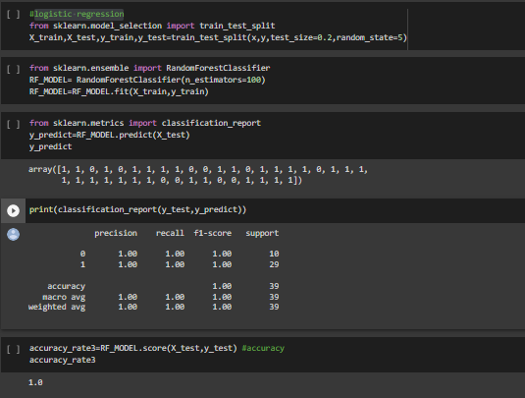
logistic regression

Slide 17
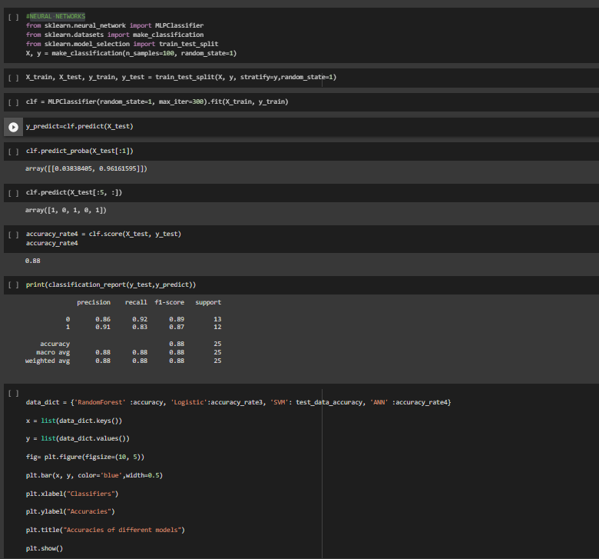
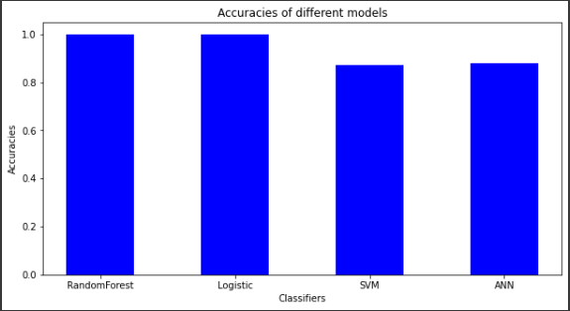
NEURAL NETWORKS

Slide 18
THE END

